Slide 2
Gathering Music
"Sleepers awake"
- J. S. Bach

Slide 3
Now thank we all our God,
Now thank we all our God,
with heart and hands
and voices,
who wondrous things has done,
in whom this world rejoices;

Slide 4
who from our
mothers‘ arms
has blessed us
on our way
with countless gifts of love,
and still is ours today.

Slide 5
O may this bounteous God
through all our life
be near us,
with ever joyful hearts
and blessed peace
to cheer us;

Slide 6
and keep us still in grace,
and guide us
when perplexed;
and free us from all ills,
in this world and the next.

Slide 7
All praise and thanks to God the Father now be given;
the Son, and
him who reigns
with them in
highest heaven;

Slide 8
the one eternal God,
whom earth
and heaven adore;
for thus it was, is now,
and shall be evermore.

Slide 9
Congregational Prayer
Gracious God, thank you for the opportunities and blessings you have given me. Lord, fill my heart with thankfulness and generosity. Amen.

Slide 10
Passing the Peace of Christ

Slide 11
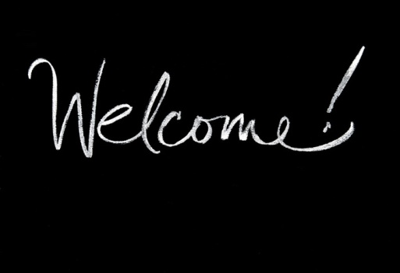
Welcome!
We’re glad you’re here.
Please fill out the registration pads and pass them to the center aisle.

Slide 12
We are the Chruch
I am the church!
You are the church!
We are the church together!
All who follow Jesus,
all around the world!
Yes, we're the church together!

Slide 13
The church is
not a building,
the church is not a steeple,
the church is not a
resting place,
the church is a people.

Slide 14
I am the church!
You are the church!
We are the church together!
All who follow Jesus,
all around the world!
Yes, we're the church together!

Slide 16
Prayers of the People

Slide 17
The Lord’s Prayer
Our Father, who art in heaven, hallowed be thy name. Thy kingdom come, thy will be done, on earth as it is in heaven.

Slide 18
Give us this day our daily bread. And forgive us our trespasses as we forgive those who trespass against us.

Slide 19
And lead us not into temptation, but deliver us from evil. For thine is the kingdom and the power, and the glory forever. Amen.

Slide 20
Matthew 6: 25-33
²⁵“Therefore I tell you, do not worry about your life, what you will eat or what you will drink, or about your body, what you will wear. Is not life more than food, and the body more than clothing?

Slide 21
²⁶Look at the birds of the air; they neither sow nor reap nor gather into barns, and yet your heavenly Father feeds them. Are you not of more value than they?

Slide 22
²⁷And can any of you by worrying add a single hour to your span of life? ²⁸And why do you worry about clothing? Consider the lilies of the field, how they grow;

Slide 23
they neither toil nor spin, ²⁹yet I tell you, even Solomon in all his glory was not clothed like one of these. ³⁰But if God so clothes the grass of the field,

Slide 24
which is alive today and tomorrow is thrown into the oven, will he not much more clothe you—you of little faith? ³¹Therefore do not worry, saying,

Slide 25
‘What will we eat?’ or ‘What will we drink?’ or ‘What will we wear?’ ³²For it is the Gentiles who strive for all these things; and indeed your heavenly Father knows that you need all these things.

Slide 26
³³But strive first for the kingdom of God and his righteousness, and all these things will be given to you as well.

Slide 27
This is the Word of the Lord.
Thanks be to God!

Slide 28
No Worries

Slide 29
Invitation to the Offering
Sophie Webster

Slide 30
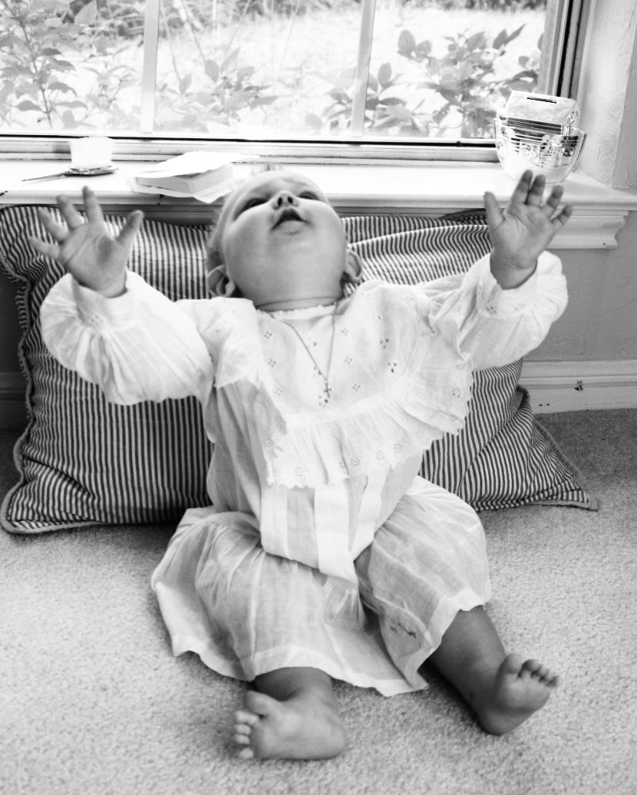
Sophie Webster

Slide 31
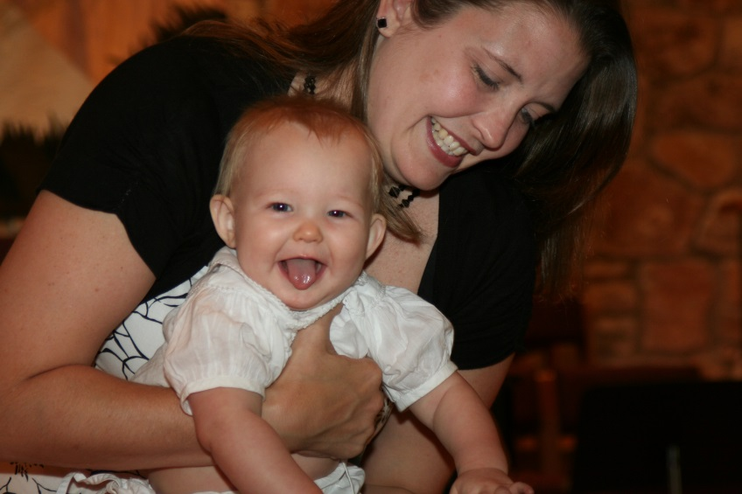
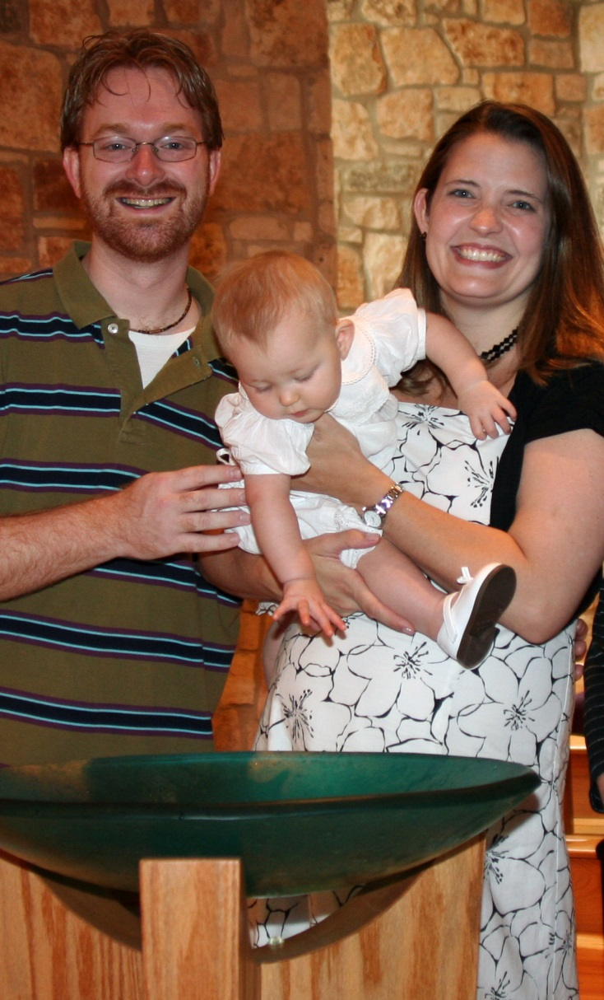
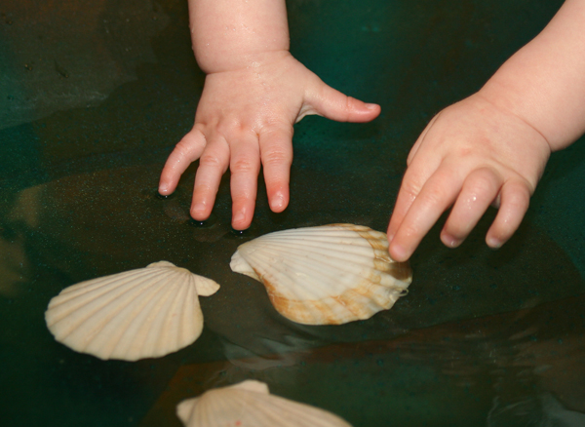

Slide 32
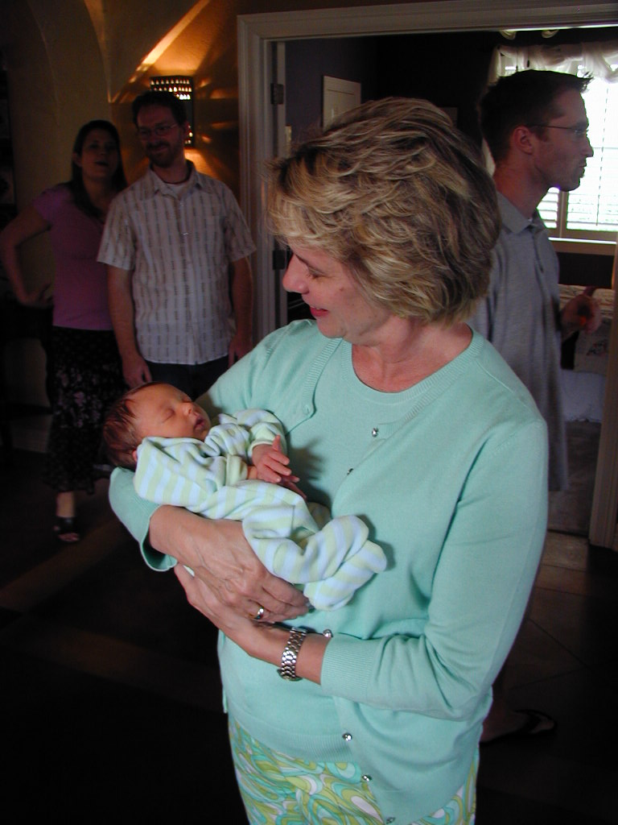
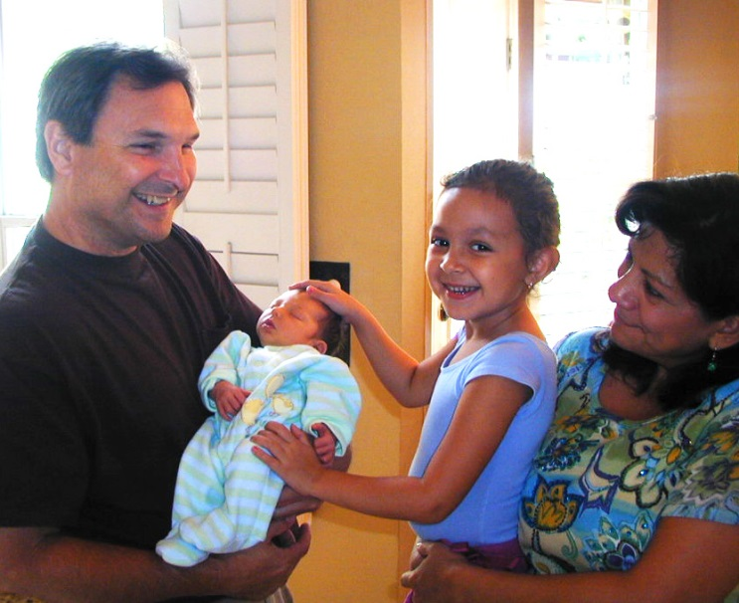

Slide 33
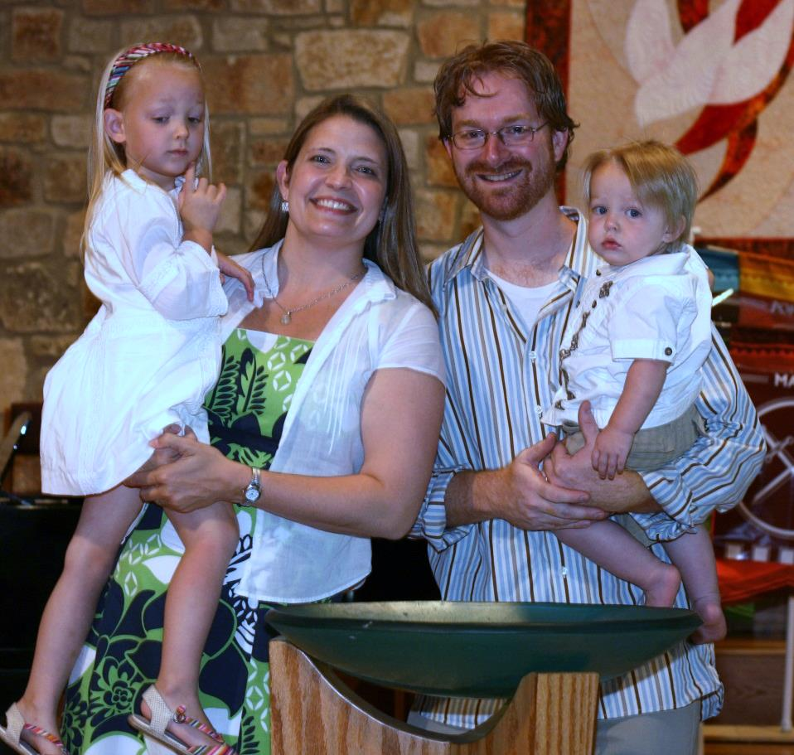
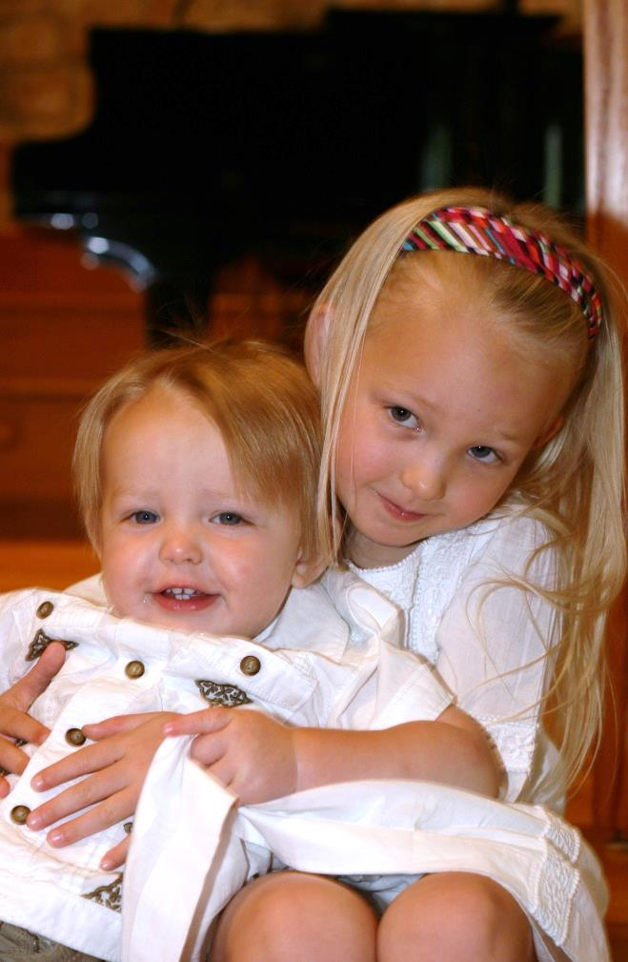

Slide 34
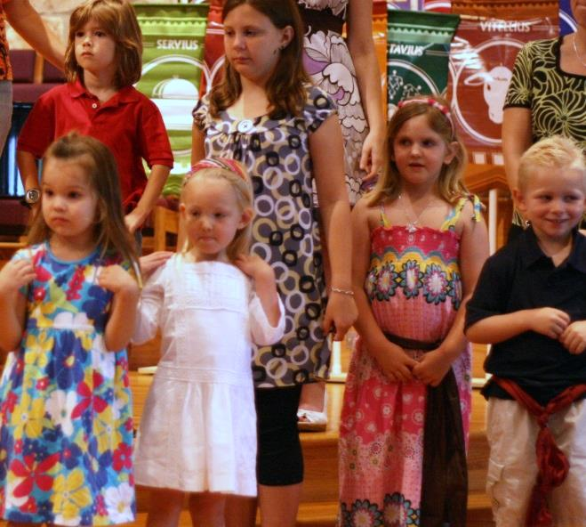
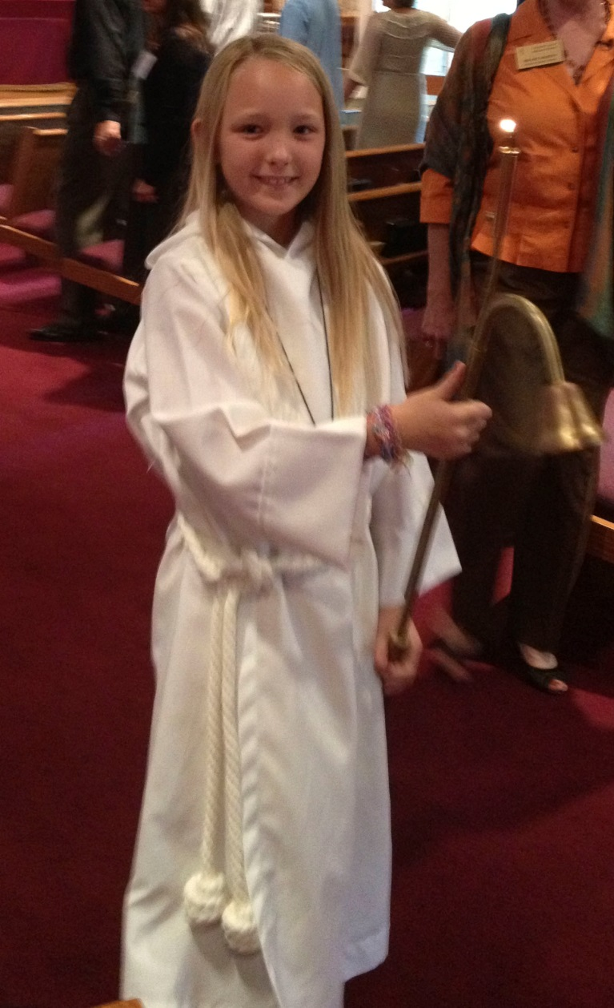
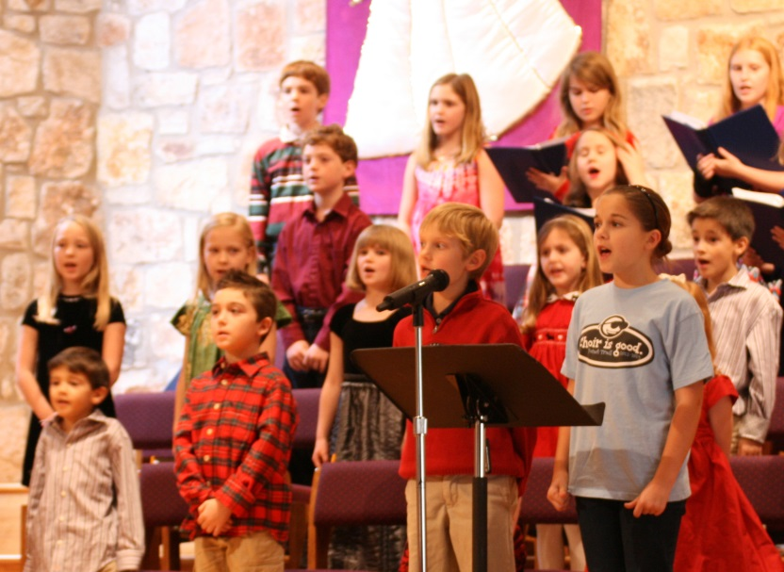

Slide 35
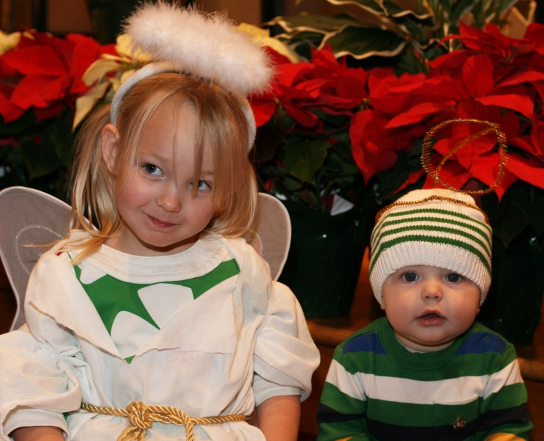
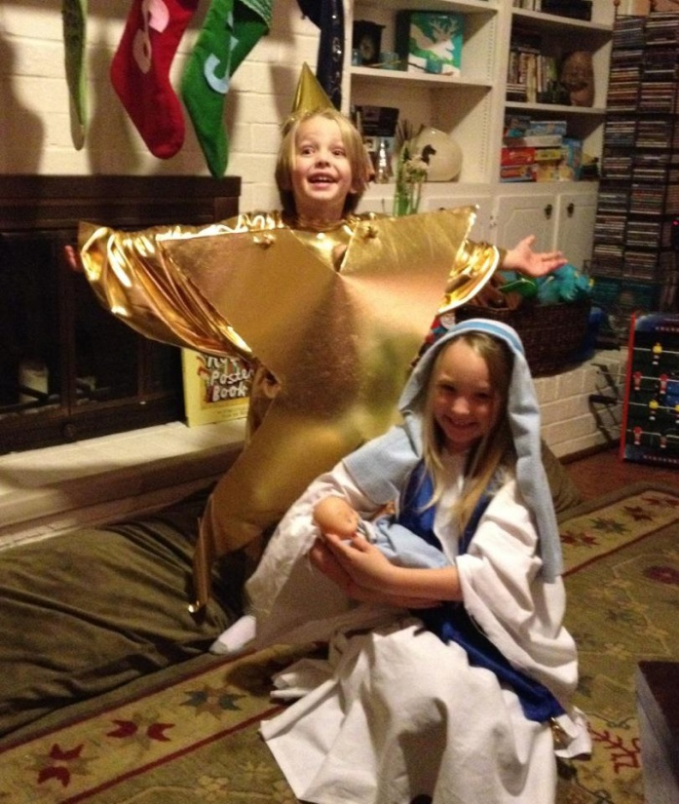
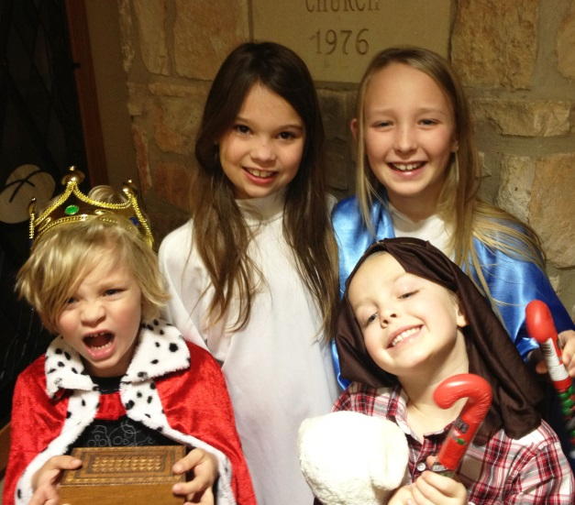

Slide 36
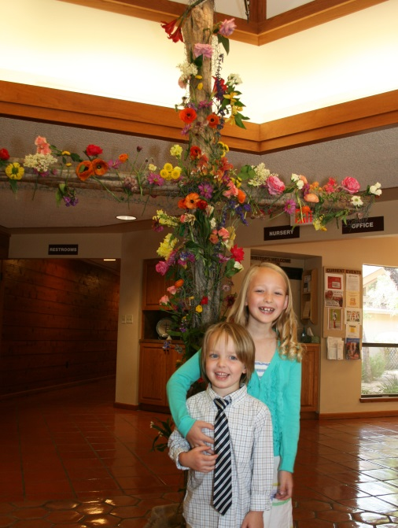
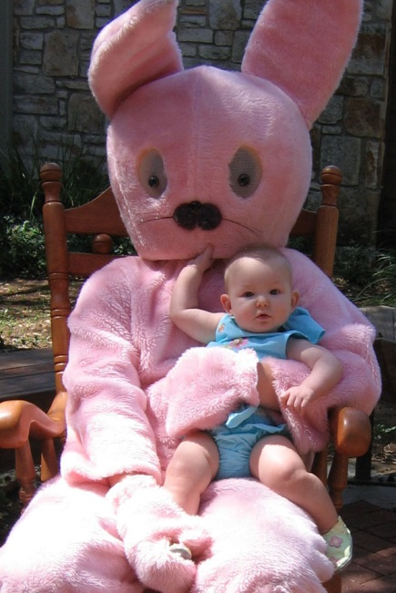
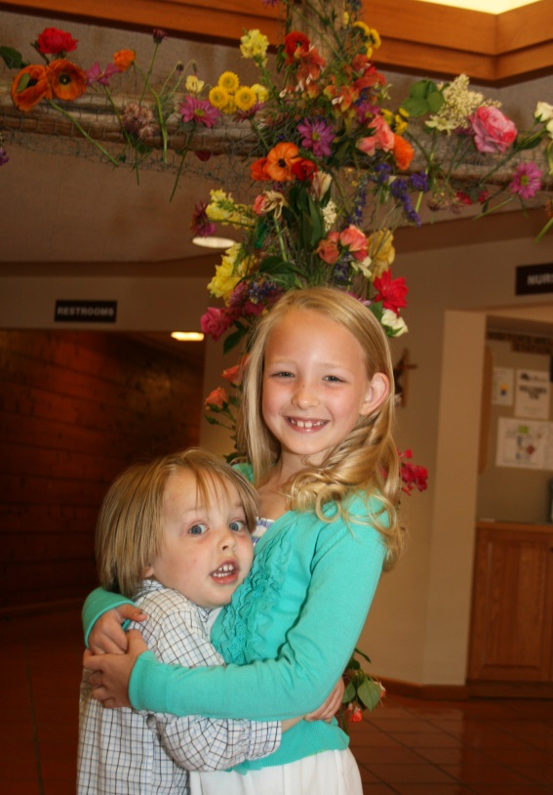
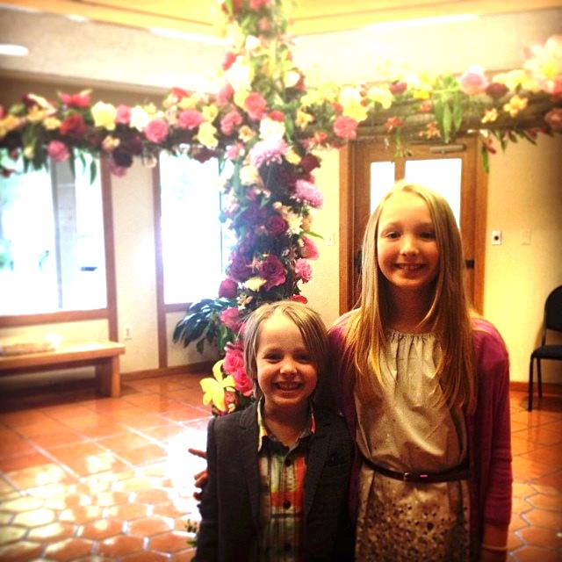

Slide 37
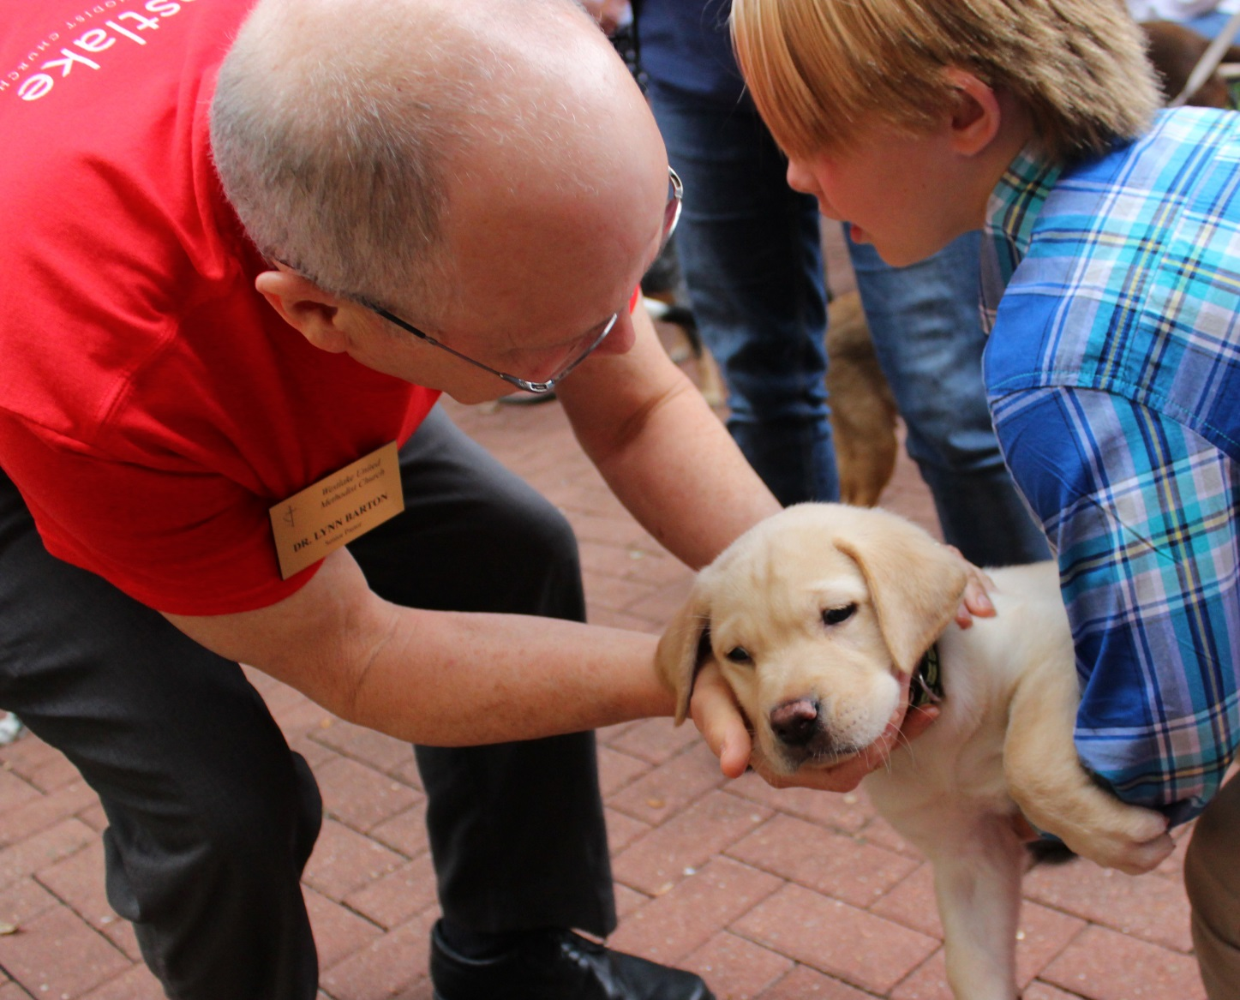

Slide 38
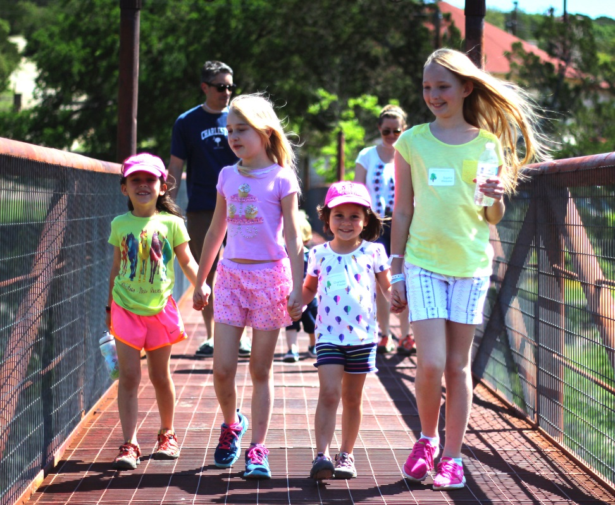
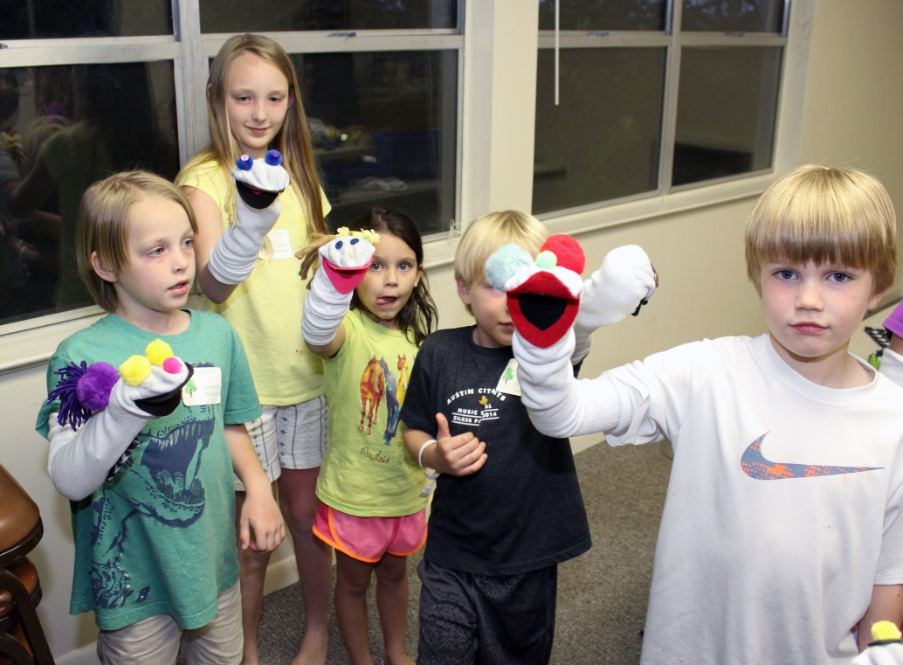

Slide 39
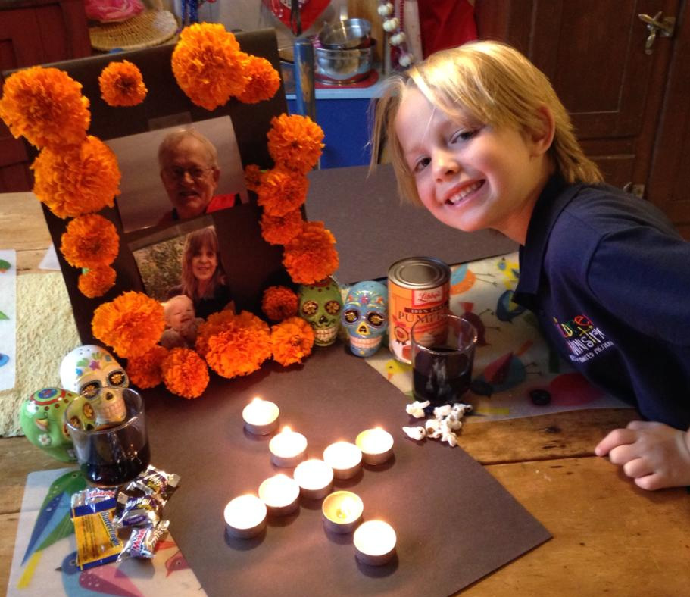

Slide 40
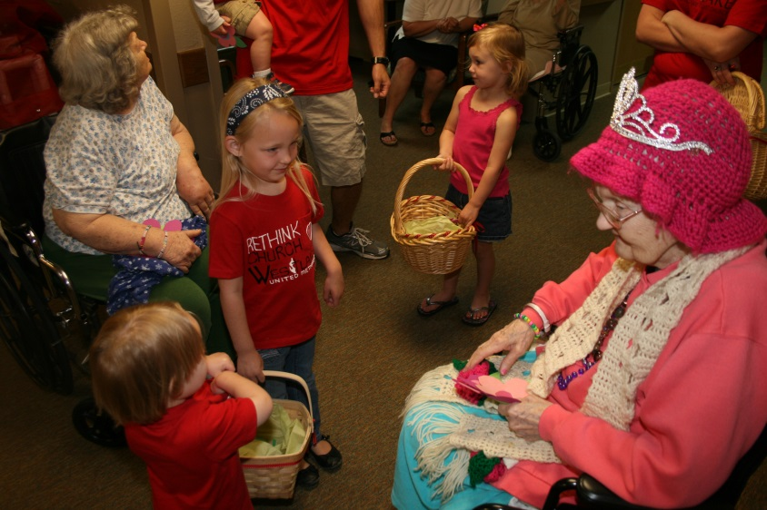
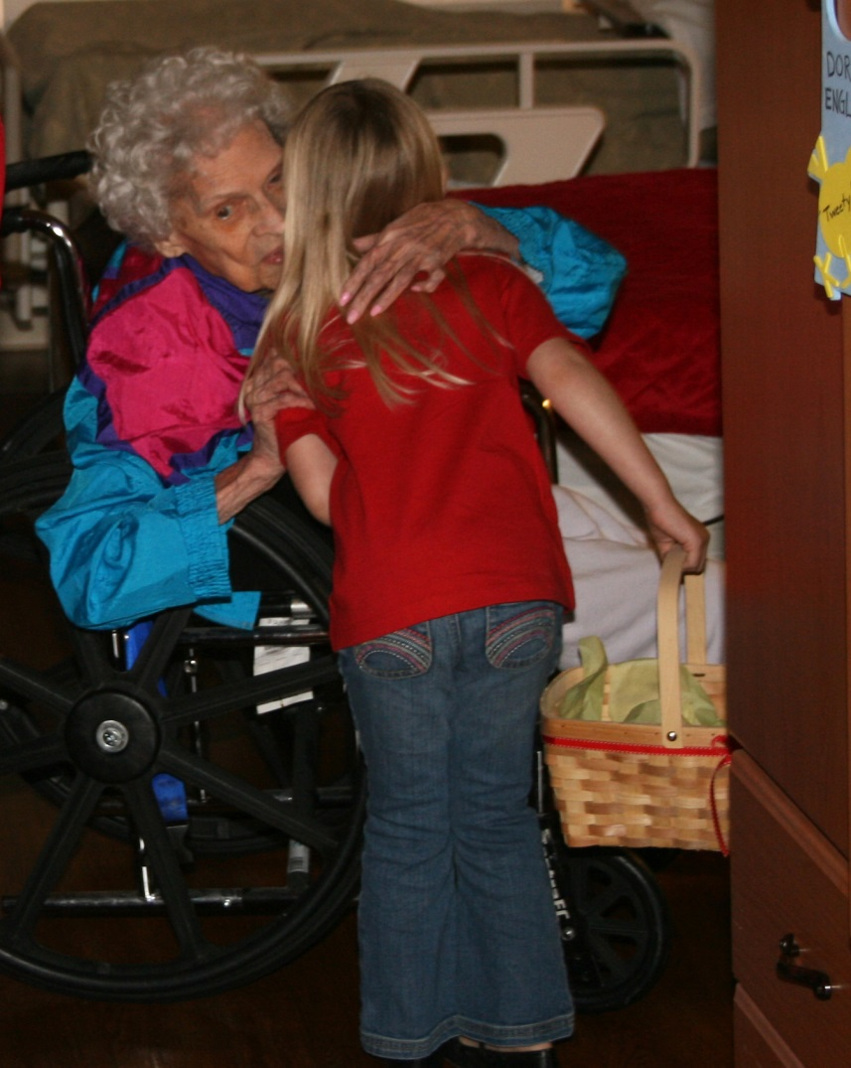
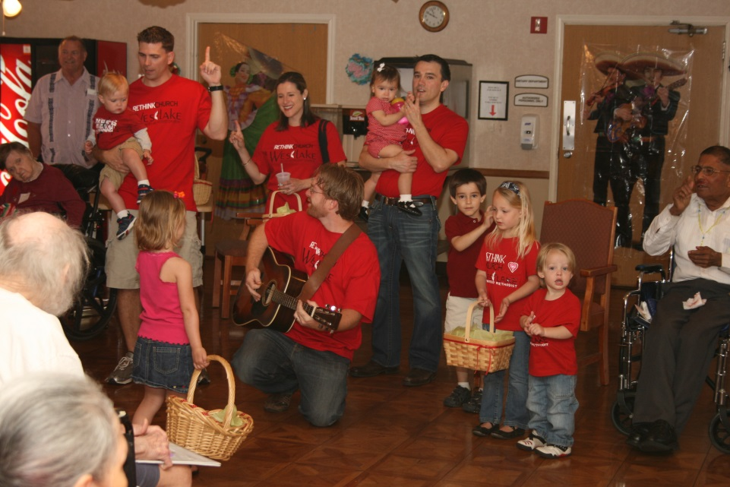

Slide 41
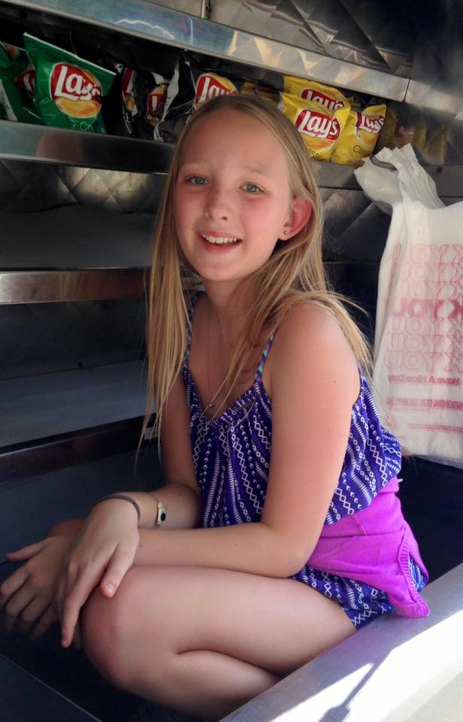
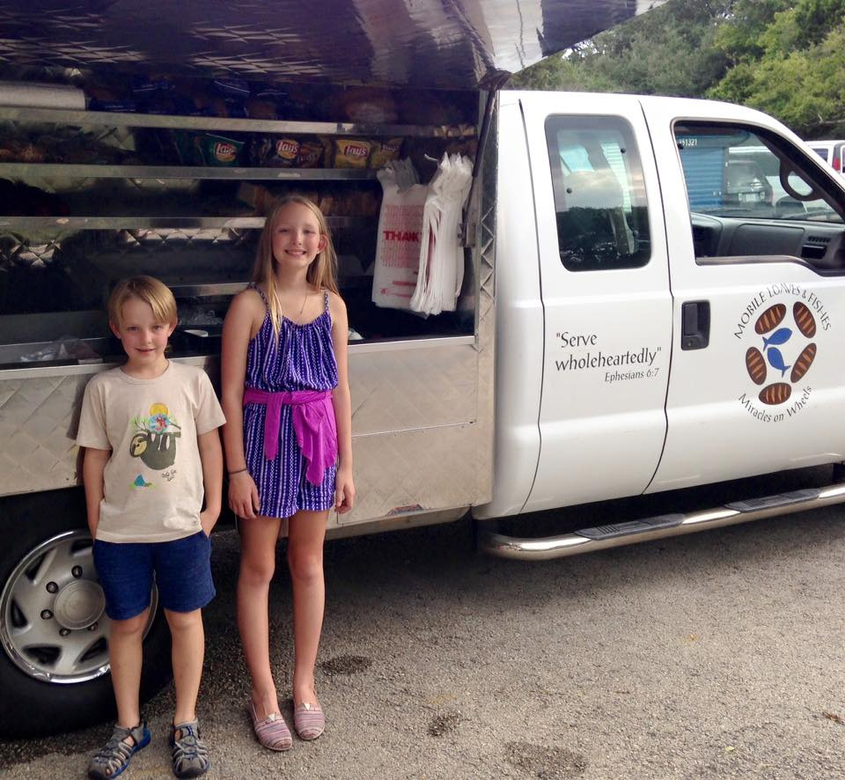

Slide 42
Offertory

Slide 43
Offertory
“To Build the Kingdom”
-Tim Bushong
The Chancel and
Youth Choirs

Slide 44
Doxology
Praise God,
from whom all blessings flow;
Praise God,
all creatures here below:
Alleluia! Alleluia!

Slide 45
Praise God,
the source of all our gifts!
Praise Jesus Christ,
whose power uplifts!
Praise the Spirit, Holy Spirit!
Alleluia! Alleluia! Alleluia!

Slide 47
I will trust in the Lord
I will trust in the Lord,
I will trust in the Lord,
I will trust in the Lord,
till I die;

Slide 48
I will trust in the Lord,
I will trust in the Lord,
I will trust in the Lord,
till I die.

Slide 49
Sister will you trust in the Lord?
Sister will you trust in the Lord?
Sister will you trust in the Lord
till you die?

Slide 50
Sister will you trust in the Lord?
Sister will you trust in the Lord?
Sister will you trust in the Lord
till you die?

Slide 51
Brother will you trust in the Lord?
Brother will you trust in the Lord?
Brother will you trust in the Lord
till you die?

Slide 52
Brother will you trust in the Lord?
Brother will you trust in the Lord?
Brother will you trust in the Lord
till you die?

Slide 53
Preacher will you trust in the Lord?
Preacher will you trust in the Lord?
Preacher will you trust in the Lord
till you die?

Slide 54
Preacher will you trust in the Lord?
Preacher will you trust in the Lord?
Preacher will you trust in the Lord
till you die?

Slide 55
Reception of New Members
We rejoice to recognize you as members of Christ's holy church and welcome you to this congregation of the United Methodist Church.

Slide 56
Reception of New Members
With you we renew our vows to uphold it by our prayers, our presence, our gifts, our service, and our witness.

Slide 57
Sending Forth

Slide 58
Go Now in Peace
Go now in peace.
Never be afraid.
God will go with you
each hour of every day.

Slide 59
Go now in faith,
steadfast,
strong and true.
Know God will guide you
in all you do.

Slide 60
Postlude

