Slide 1
Parenthetical Documentation
How to steal and not be a plagiarist!

Slide 2
Purpose
With parenthetical documentation, you tell the reader where the information in your research paper came from. This is done by putting the author’s last name or part of the title of your source in parentheses after the info appears in the text.
It looks like this (Davidson 12) where the number is the page on which the information appears.
Cite quotes, paraphrases, and anything else which is not 100% original from your own head.

Slide 3
Technique
When you have info on a notecard, you should know exactly where it came from.
Showmanship
4
Hendrix burned his guitar to out-perform Pete Townshend of The Who who had smashed his guitar through an amplifier.
4
“Hey dough! Jimi Hendrix's favourite guitar which he switched before setting cheaper version on fire sells for £250,000.” Daily Mail Online. Associated Newspapers Ltd, 28 November 2012. Web. 10 Oct. 2014.

Slide 4
Sources with no author listed
When he set his guitar on fire, Hendrix was trying to out-perform Pete Townsend who had smashed his guitar on the stage earlier in the day (“Hey”).
In the sample above, the info came from a website article entitled “Hey dough! Jimi Hendrix's favourite guitar which he switched before setting cheaper version on fire sells for £250,000.”
Because the website is unsigned, you cite the source with the first significant word of the title.

Slide 5
Basic Documentation
^{(Macrorie 153)}
(Winterowd and Murray 278) [two authors]
(Kells et al. 49) [three or more authors]

Slide 6
Punctuation
Be sure to put the citation inside the sentence, to the left of the period (Jones and McCord 26).
When quoting, be sure the citation is not “part of the quote itself” (Chuah 6).
Use quotation marks in the citation if there is no listed author of an article or web page (“Puctuating”).
Italicize the citation if there is no listed author and you would normally italicize the work (Jaws).

Slide 7
Using a source more than once
One proposal from the committee for a protest march grew into a coordinated effort in twenty countries (Perry 25). Mario Savio helped organize a demonstration against Navy recruiters at Berkeley (110). During the protest, people began to sing the recent Beatles hit, “Yellow Submarine” (110). Savio declared “Yellow Submarine” was “an unexpected symbol of our trust in the future and of our longing for a place for all of us to live” (111).

Slide 8
More than one source by one author
Jimi Hendrix was know for his “touch, tone, and technique” on guitar (Krebbs, How 13) as much as for his “incendiary showmanship” (Krebbs, “Fire”).
In the above example, Krebbs has written a book entitled How to Play Rock Guitar. The same author has an article entitled “The Fire of Jimi Hendrix.” Use the author’s last name followed by a comma and the first word which specifies the source.
Note also that citations can occur mid-sentence.

Slide 9
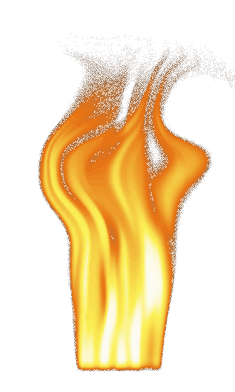
Remember kids, if you cite your sources well, it gives you credibility. It makes you awesome.

