Slide 1
Thesis Statements
Kealing 8th Grade
Magnet English
Notes:
Hello! This is Ms. Saribudak. I’m going to go over crafting thesis statements for research papers. Thesis statements can be challenging to write, but if you create a strong one, it will guide your research and make your paper easier to organize and write.

Slide 2
What is a thesis statement?
It’s a one sentence statement that reveals the purpose and organization of your paper.
It is NOT:
a question
a series of statements
a paragraph

Slide 3
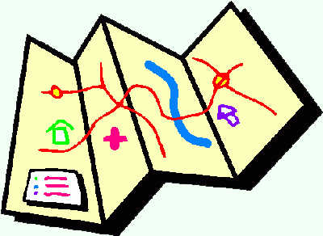
Think of your thesis as the “road map” to your paper
CLEAR and SPECIFIC
Notes:
Think of your thesis statement as a “road map” of your paper. Be clear and specific so your reader knows what to expect.

Slide 4
What should your thesis include?
1) Topic
2) Assertion
3) Major points
* Be prepared to answer the question: “So what?”

Slide 5
Examples
1) The federal government needs to strongly regulate industrial agriculture in light of its abuses against employees, animals, and the environment.
2) Industrial agriculture is problematic in light of its abuses against employees, animals, and the environment.
Notes:
Go ahead and locate the topic, claim, and major points.
How would you expect this paper to be outlined?
Which of these two statements are stronger? The second one uses passive voice and doesn’t answer the question “So what?”

Slide 6
Examples cont’d
Although genetically modified foods are touted as safe for human consumption, GMOs should be illegal because of negative environmental effects such as cross pollination, toxicity, and the development of “super weeds.”
Notes:
Again look for topic, claim, and major points.
Note that this statement is slightly different than the first one because it starts with a concession. In rhetoric, a concession is the act of accepting something that’s true on the other side of the argument.
Having a concession in your thesis raises the interest level of your thesis.

Slide 7
Important note
Your topic may change as you write, so you may need to revise your thesis statement to reflect exactly what you have discussed in the paper.
Notes:
For example, if I researched more about GMOs, and I discovered something more negative for the environment than the development of “super weeds,” I would need to go back and adjust my thesis statement.

Slide 8
Important note
Your topic may change as you write, so you may need to revise your thesis statement to reflect exactly what you have discussed in the paper.
Notes:
For example, if I researched more about GMOs, and I discovered something more negative for the environment than the development of “super weeds,” I would need to go back and adjust my thesis statement.

Slide 9
Activity
What is my paper about?
What is my stance about this topic?
How am I going to prove my stance?
What can my readers or society do about this topic?
Notes:
Now I’d like you to think about the information that you know and have learned about your topic, and answer the following questions.

