Slide 2
My Savior My God
I am not skilled to understand
What God has willed,
what God has planned
I only know at His right hand
Stands one who is my Savior

Slide 3
I take Him at His word and deed
Christ died to save me;
this I read
And in my heart I find a need
Of Him to be my savior

Slide 4
That He would leave
His place on high
And come for sinful
man to die

Slide 5
You count it strange,
so once did I
Before I knew my Savior

Slide 6
My Savior loves, My Savior lives
My Savior’s always there for me
My God: He was
My God: He is
My God is always gonna be

Slide 7
Yes, living, dying,
let me bring
My strength, my solace
from this spring;

Slide 8
That He who lives
to be my King
Once died to be my Savior

Slide 9
That He would leave
His place on high
And come for sinful
man to die

Slide 10
You count it strange,
so once did I
Before I knew my Savior

Slide 11
My Savior loves, My Savior lives
My Savior’s always there for me
My God: He was
My God: He is
My God is always gonna be

Slide 12
You Never Let Go
Even though I walk
through the valley
of the shadow of death, Your perfect love
is casting out fear.

Slide 13
And even when I’m caught
in the middle
of the storms of this life,
I won’t turn back,
I know You are near.

Slide 14
And I will fear no evil,
For my God is with me.
And if my God is with me,
Whom then shall I fear?
Whom then shall I fear?

Slide 15
Oh no, You never let go,
Through the calm
and through the storm
Oh no, You never let go,
In every high and every low

Slide 16
O no, You never let go
Lord,
You never let go of me.

Slide 17
Opening Prayer

Slide 18
And I can see a light
that is coming
for the heart that holds on
A glorious light
beyond all compare.

Slide 19
And there will be an end
to these troubles,
but until that day comes,
We’ll live to know
You’re here on the earth.

Slide 20
And I will fear no evil,
For my God is with me.
And if my God is with me,
Whom then shall I fear?
Whom then shall I fear?

Slide 21
Oh no, You never let go,
Through the calm
and through the storm
Oh no, You never let go,
In every high and every low

Slide 22
O no, You never let go
Lord,
You never let go of me.

Slide 23
Yes, I can see a light
that is coming
for the heart that holds on

Slide 24
And there will be an end
to these troubles,
but until that day comes,
Still I will praise You,
Still I will praise You.

Slide 25
Yes, I can see a light
that is coming
for the heart that holds on

Slide 26
And there will be an end
to these troubles,
but until that day comes,
Still I will praise You,
Still I will praise You.

Slide 27
Oh no, You never let go,
Through the calm
and through the storm
Oh no, You never let go,
In every high and every low

Slide 28
O no, You never let go
Lord,
You never let go of me.

Slide 29
Passing the Peace of Christ

Slide 30
Welcome!
We’re glad you’re here.
Please fill out the registration pads and pass them to the center aisle.

Slide 32
Matthew 6: 25-33
²⁵“Therefore I tell you, do not worry about your life, what you will eat or what you will drink, or about your body, what you will wear. Is not life more than food, and the body more than clothing?

Slide 33
²⁶Look at the birds of the air; they neither sow nor reap nor gather into barns, and yet your heavenly Father feeds them. Are you not of more value than they?

Slide 34
²⁷And can any of you by worrying add a single hour to your span of life? ²⁸And why do you worry about clothing? Consider the lilies of the field, how they grow;

Slide 35
they neither toil nor spin, ²⁹yet I tell you, even Solomon in all his glory was not clothed like one of these. ³⁰But if God so clothes the grass of the field,

Slide 36
which is alive today and tomorrow is thrown into the oven, will he not much more clothe you—you of little faith? ³¹Therefore do not worry, saying,

Slide 37
‘What will we eat?’ or ‘What will we drink?’ or ‘What will we wear?’ ³²For it is the Gentiles who strive for all these things; and indeed your heavenly Father knows that you need all these things.

Slide 38
³³But strive first for the kingdom of God and his righteousness, and all these things will be given to you as well.

Slide 39
This is the Word of the Lord.
Thanks be to God!

Slide 40
No Worries

Slide 41
Invitation to the Offering
Sophie Webster

Slide 42
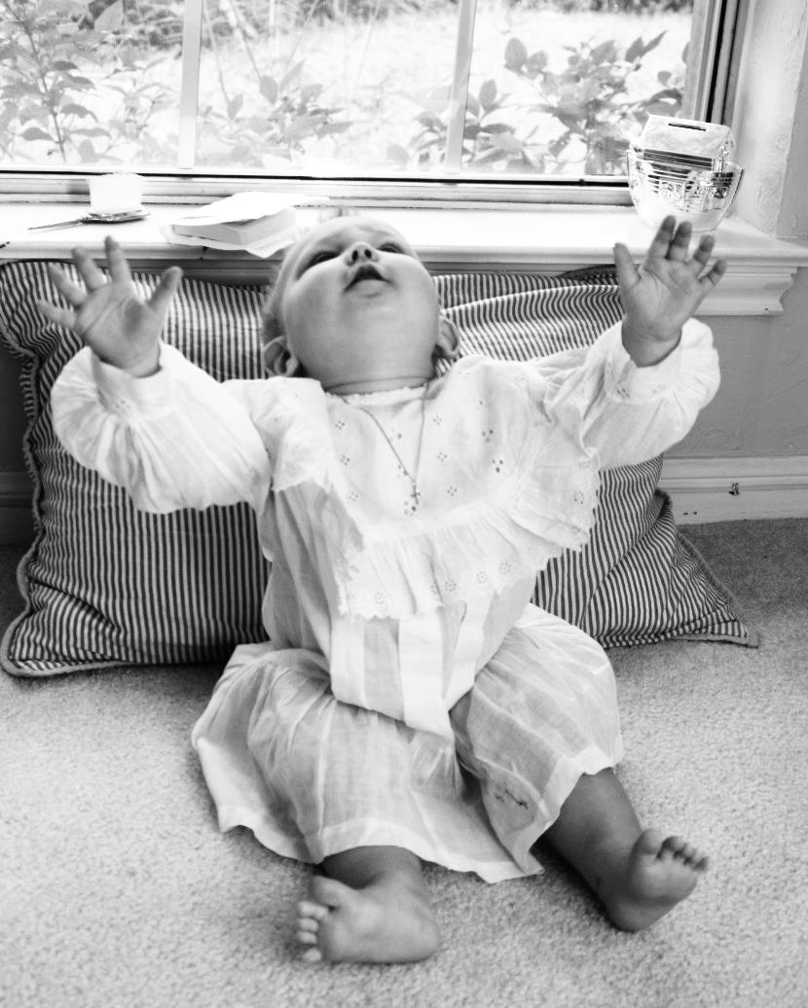
Sophie Webster

Slide 43
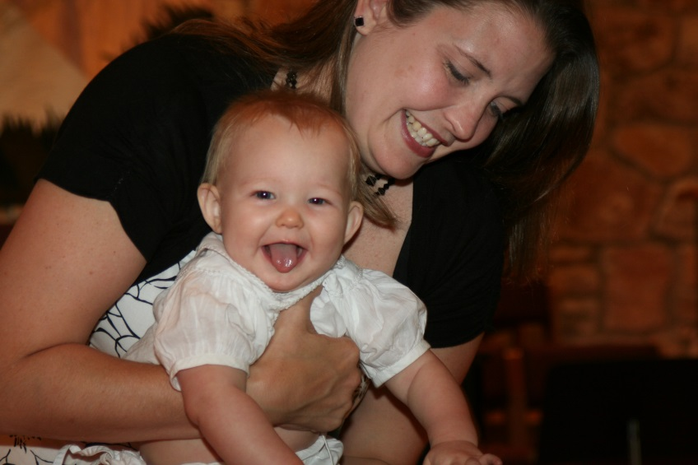
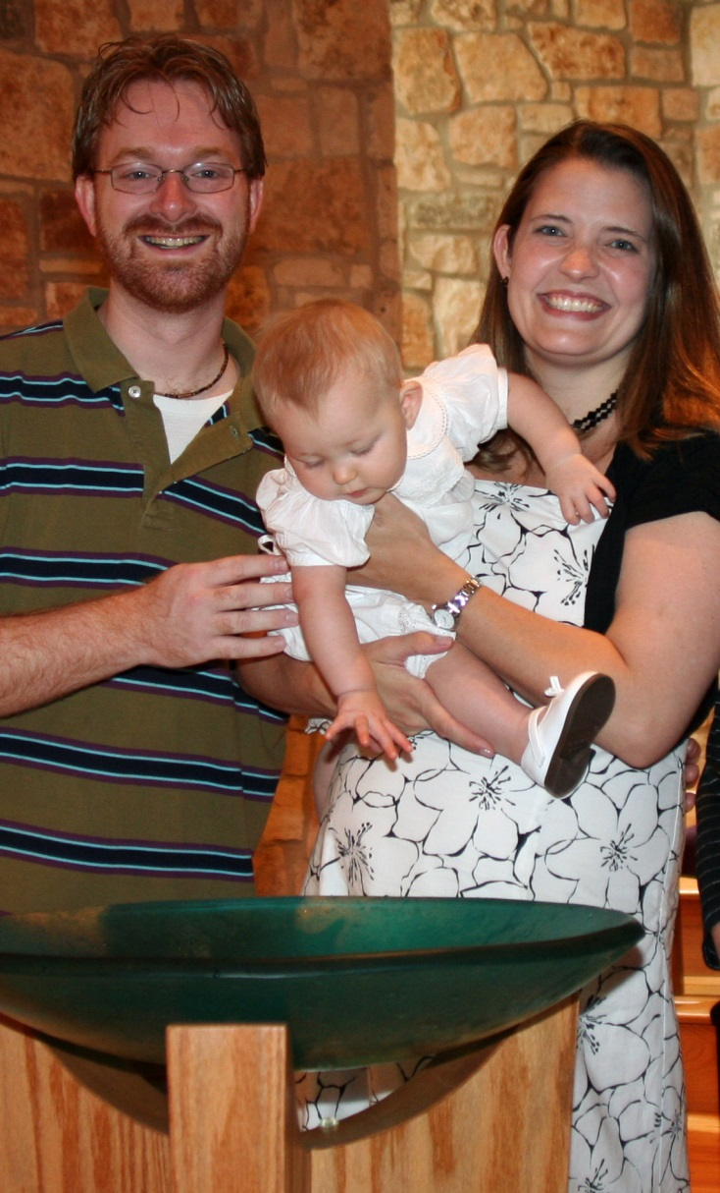
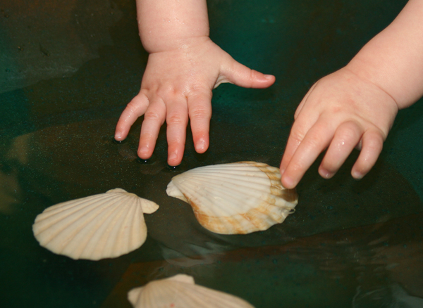

Slide 44
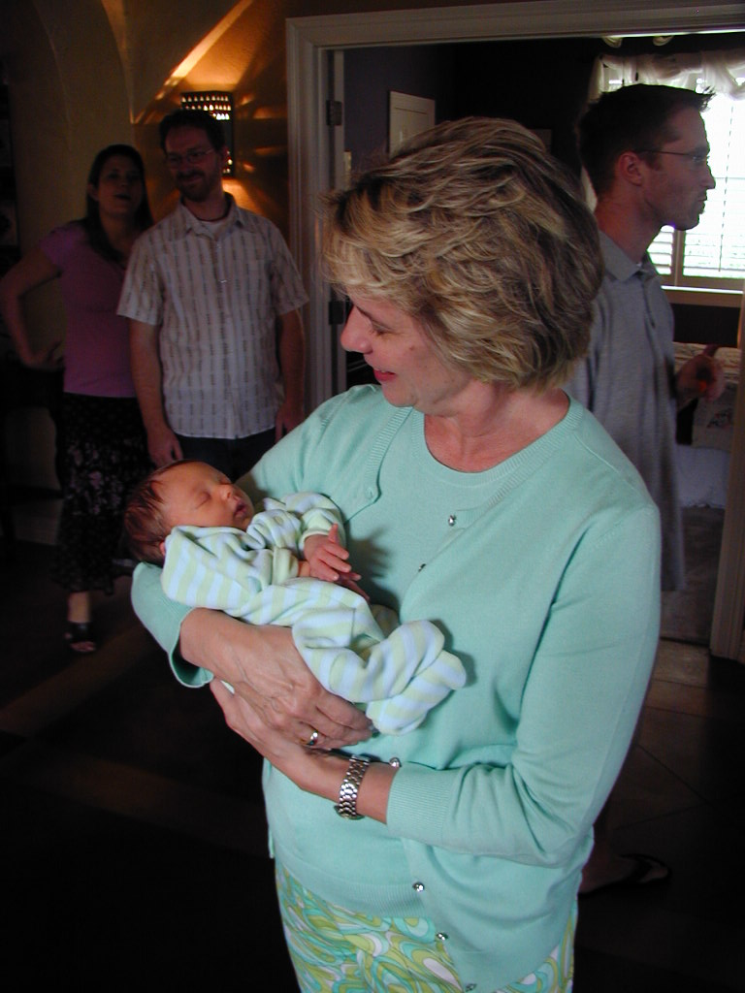
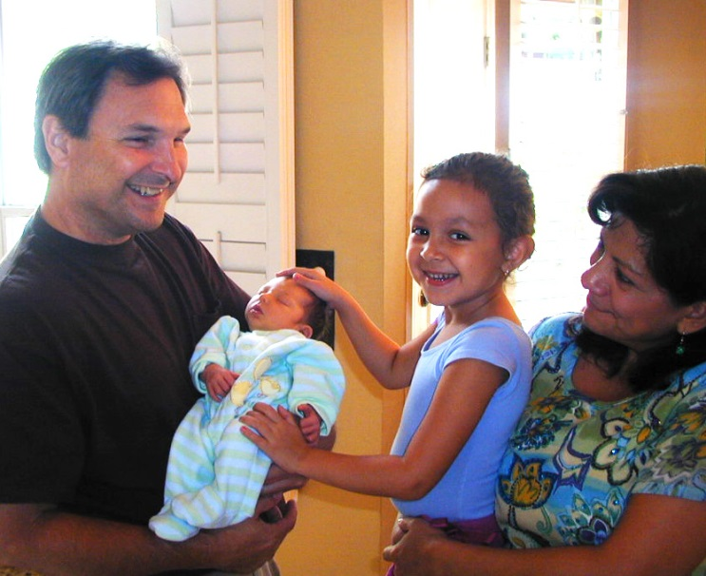

Slide 45
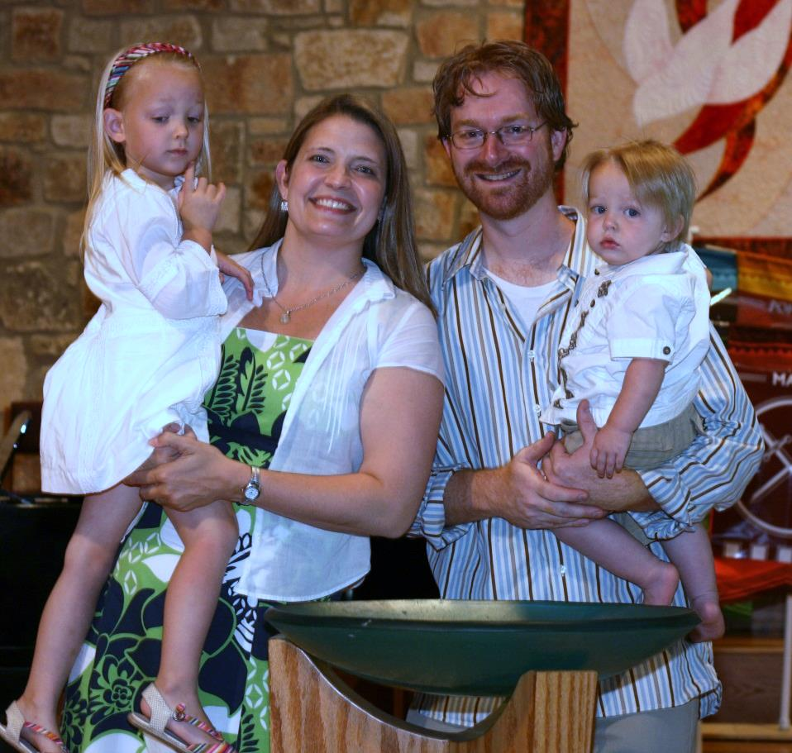
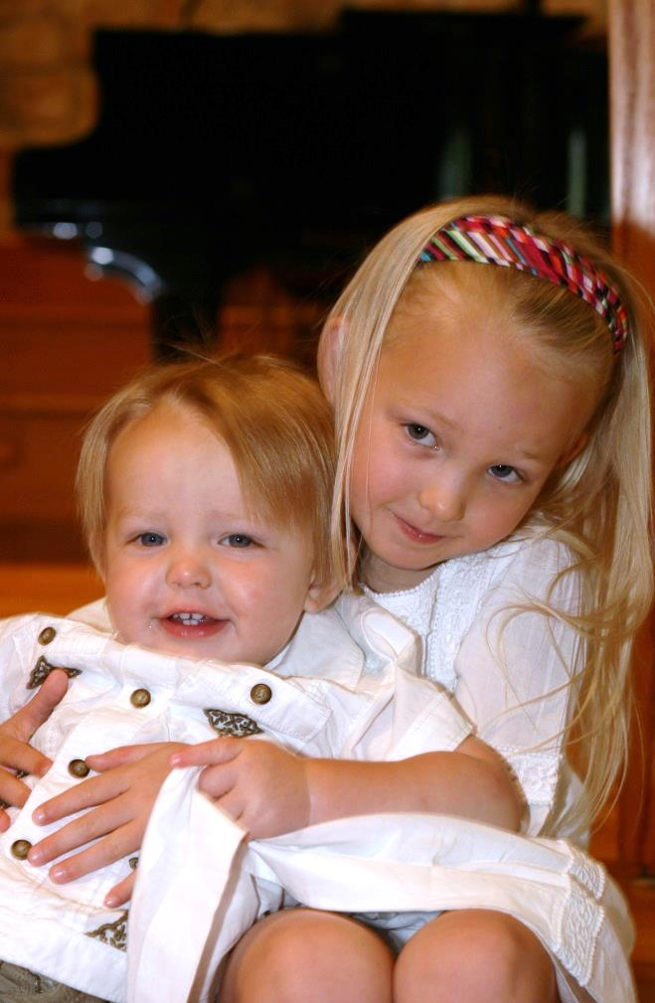

Slide 46
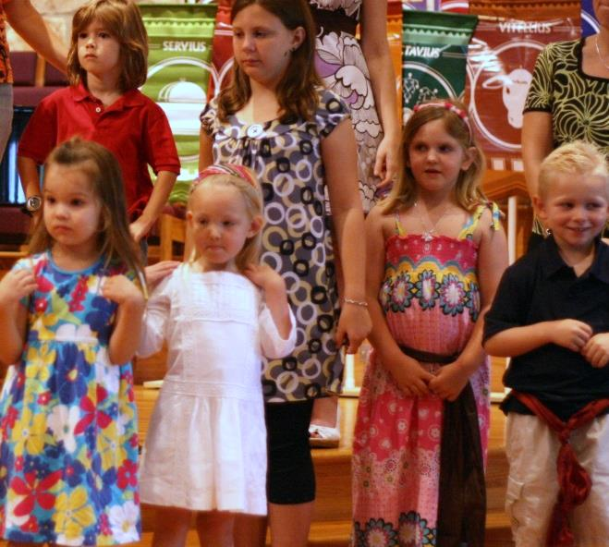
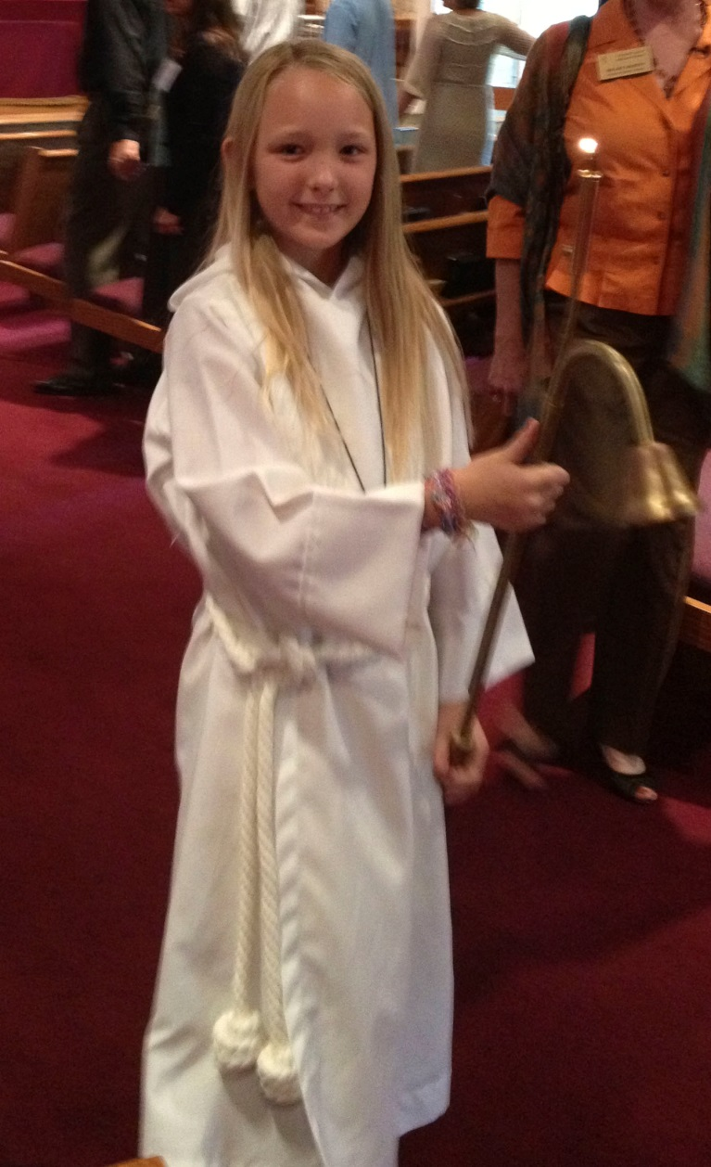
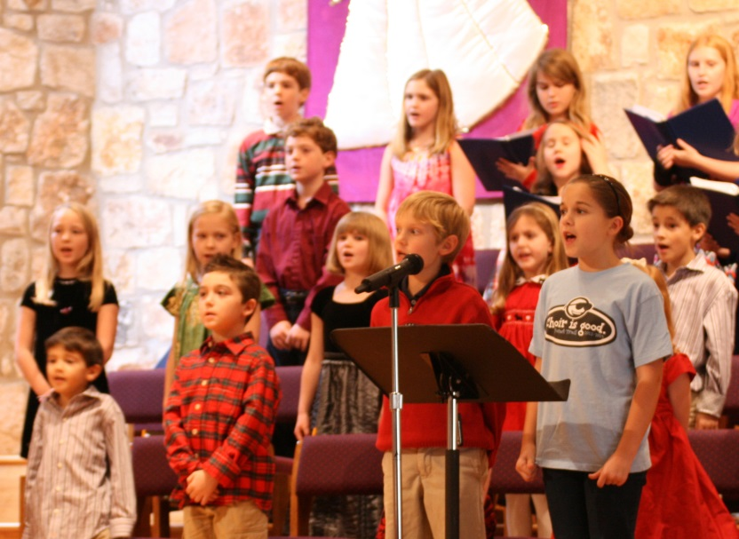

Slide 47
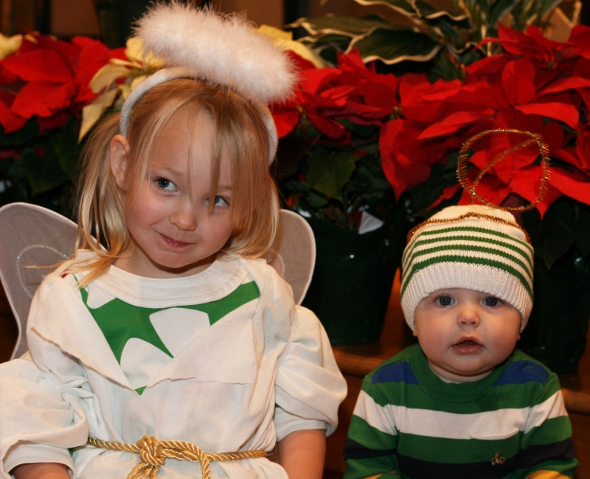
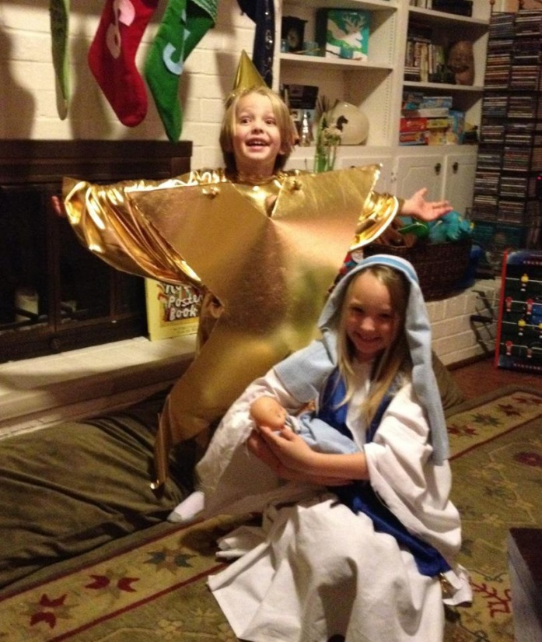
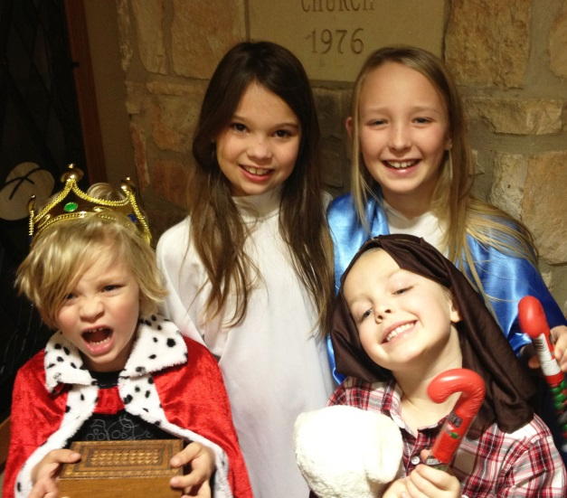

Slide 48
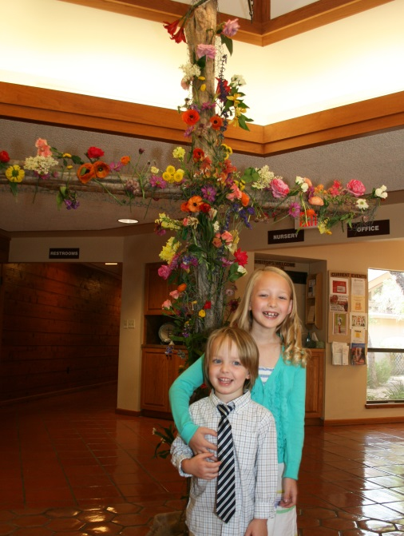
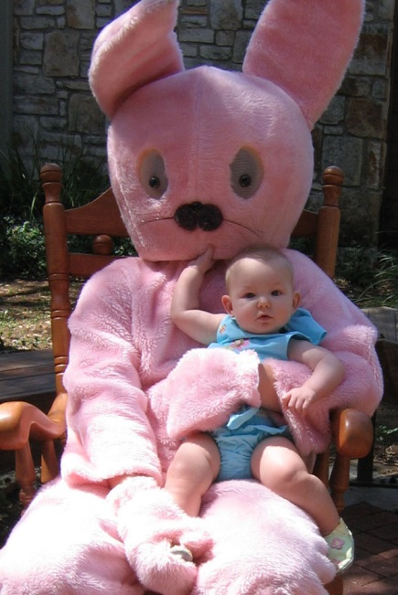
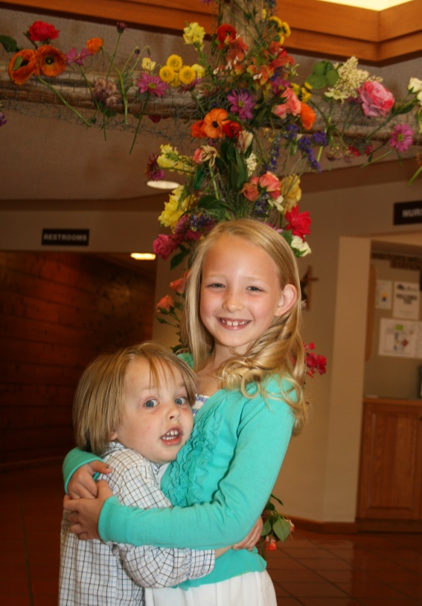
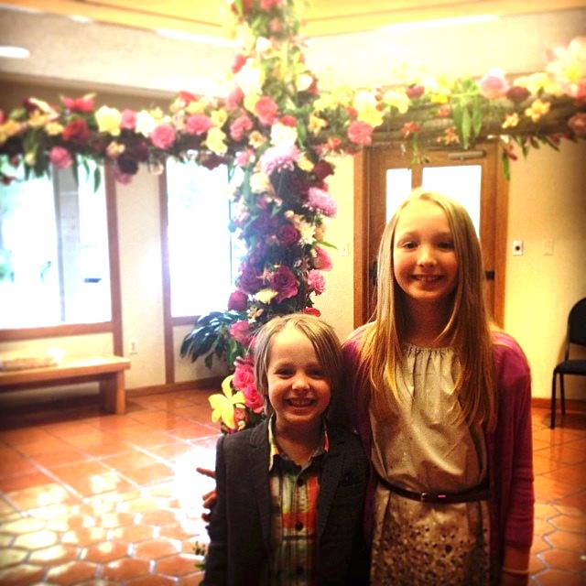

Slide 49
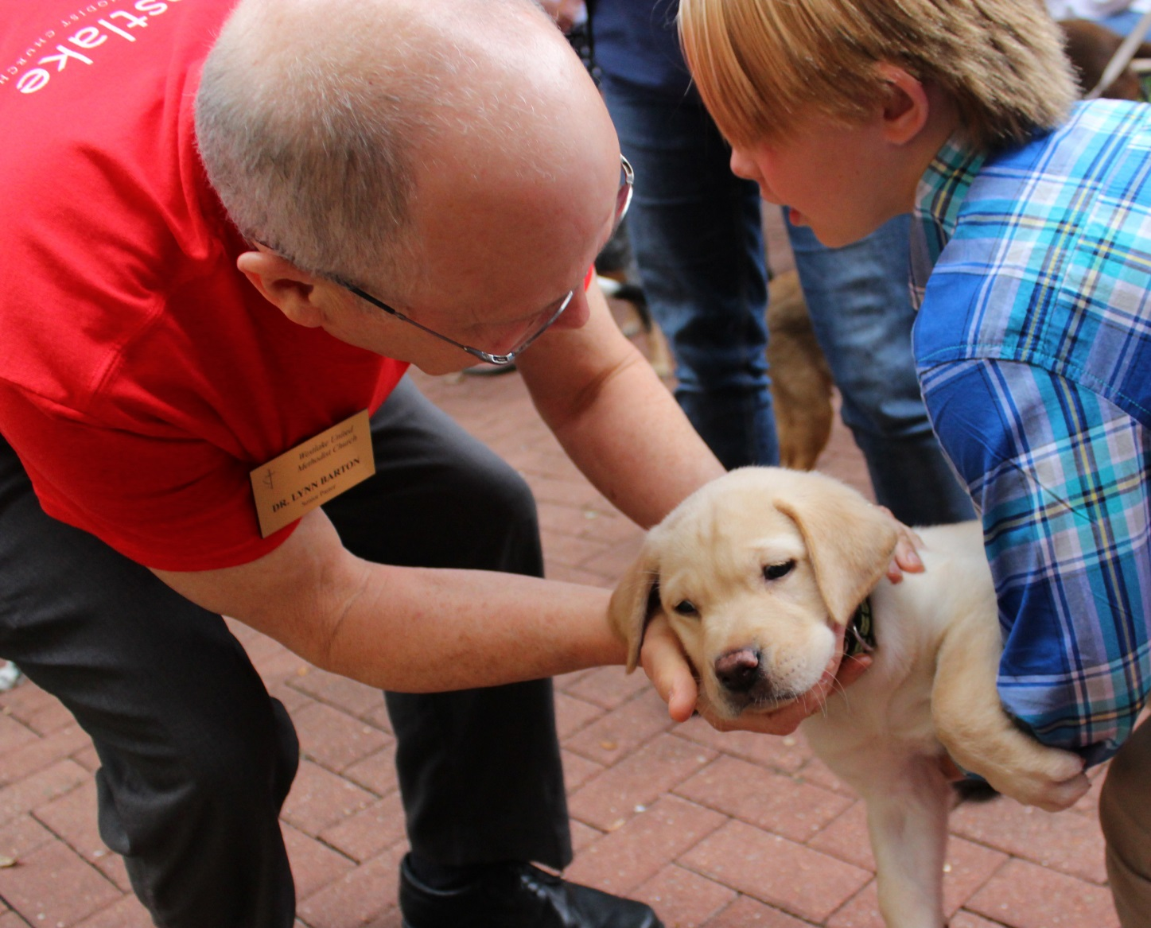

Slide 50
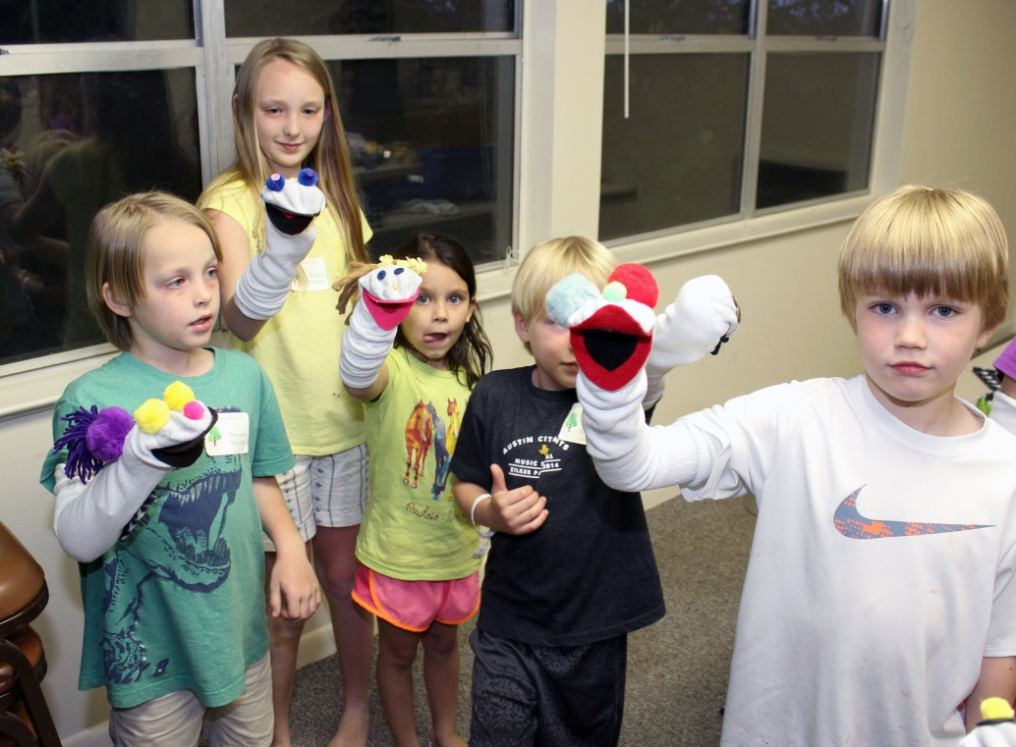

Slide 51
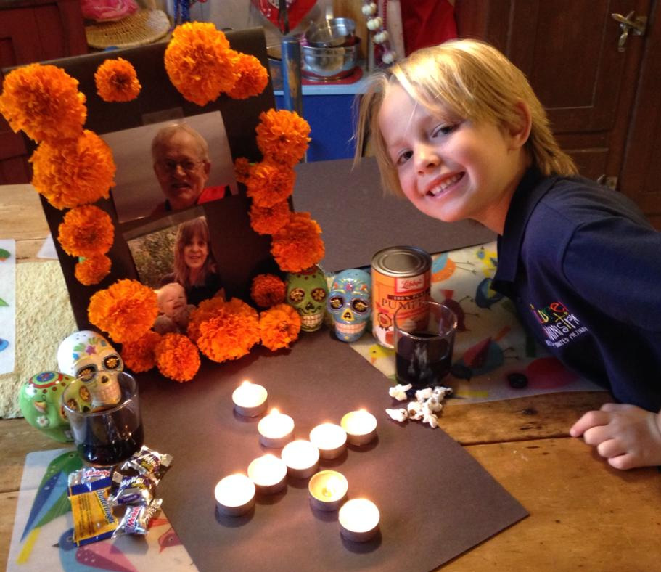

Slide 52
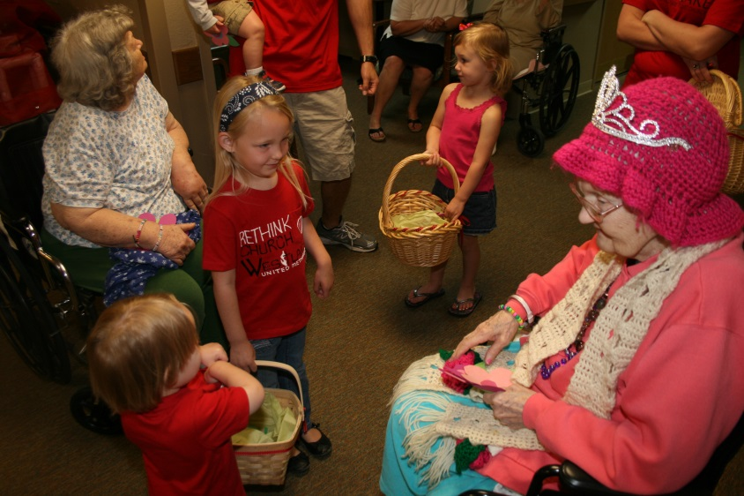
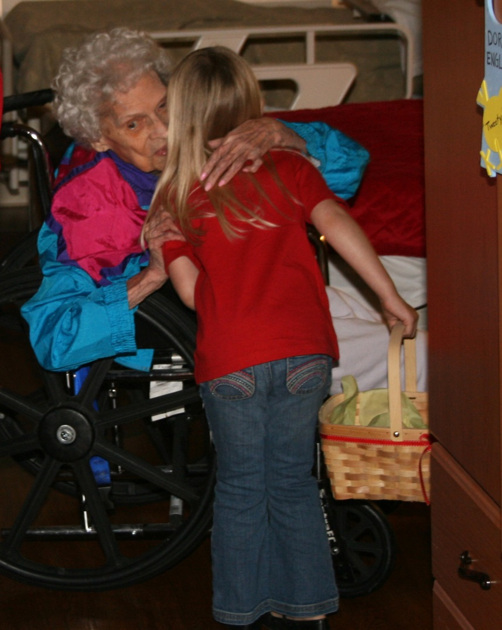
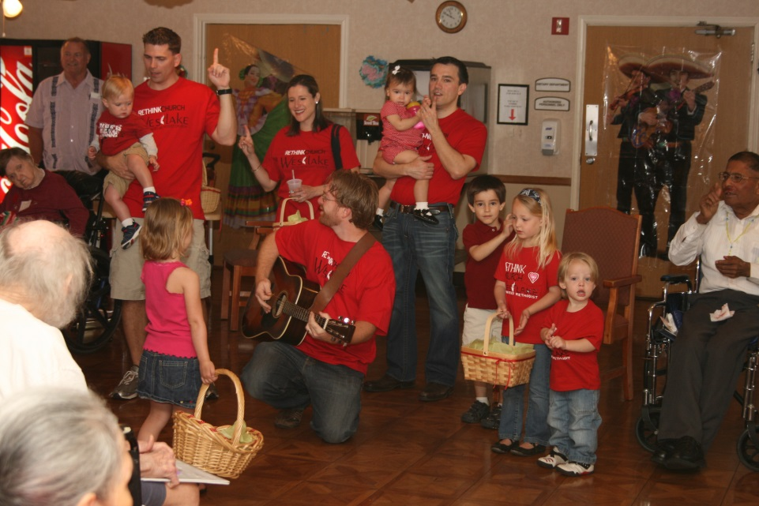

Slide 53
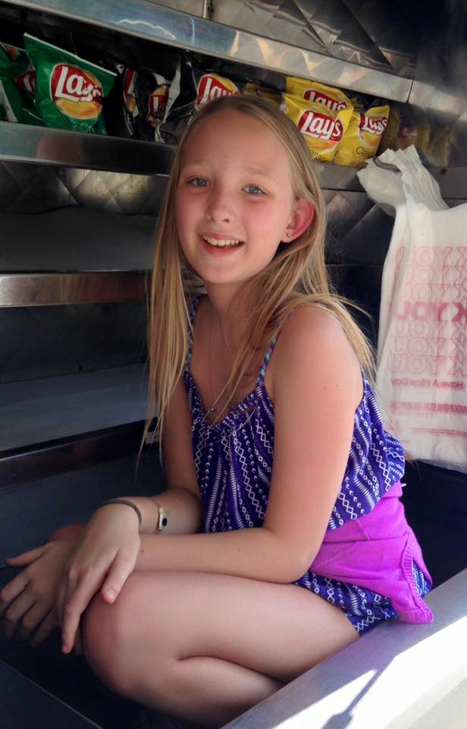
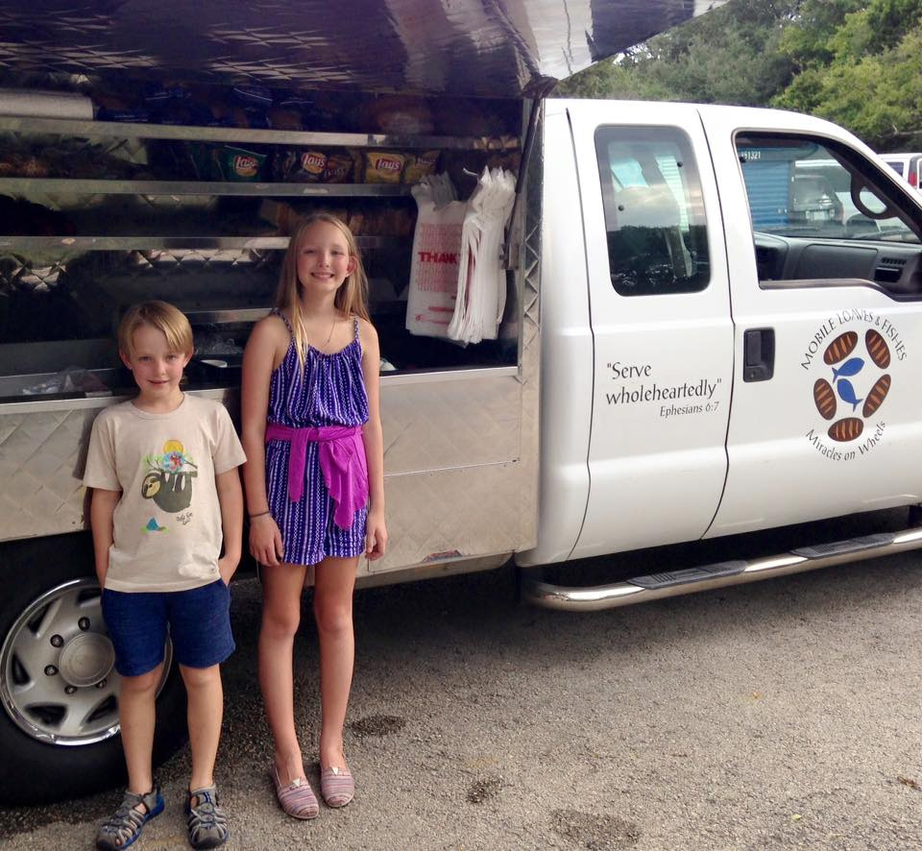

Slide 54
Offertory

Slide 55
Take My Life and Let it Be
Take my life and let it be
consecrated Lord to thee Take my moments
and my days,
let them flow
in ceaseless praise

Slide 56
Take my hands
and let them move
at the impulse of thy love Take my feet
and let them be
swift and beautiful
for thee

Slide 57
Take my voice
and let me sing,
always, only for my King Take my lips
and let them be
filled with messages
from thee

Slide 58
Take my silver and my gold,
not a mite would I withhold Take my intellect and use
every power as You choose

Slide 59
Here am I,
all of me.
Take my life,
it's all for thee.

Slide 60
Take my will
and make it thine,
it shall be no longer mine Take my heart
it is thine own,
it shall be thy royal throne

Slide 61
Take my love
my Lord I pour
at Your feet
its treasure store Take myself and I will be
ever, only, all for thee

Slide 62
Here am I,
all of me.
Take my life,
it's all for thee.

Slide 63
Here am I,
all of me.
Take my life,
it's all for thee.

Slide 64
Here am I,
all of me.
Take my life,
it's all for thee.

Slide 65
Here am I,
all of me.
Take my life,
it's all for thee.

Slide 66
Take my life
and let it be
consecrated Lord
to thee

Slide 67
Prayers of the People

Slide 68
The Lord’s Prayer
Our Father, who art in heaven, hallowed be thy name. Thy kingdom come, thy will be done, on earth as it is in heaven.

Slide 69
Give us this day our daily bread. And forgive us our trespasses as we forgive those who trespass against us.

Slide 70
And lead us not into temptation, but deliver us from evil. For thine is the kingdom and the power, and the glory forever. Amen.

Slide 72
How Great Thou Art
O Lord my God,
when I in awesome wonder
Consider all the worlds
Thy hands Have made;

Slide 73
I see the stars,
I hear the rolling thunder,
Thy power throughout
the Universe displayed

Slide 74
Then sings my soul,
my Savior God to Thee
How great Thou art,
how great Thou art!

Slide 75
Then sings my soul,
my Savior God to Thee
How great Thou art,
how great Thou art,
how great Thou art!

Slide 76
And when I think
that God His Son not sparing,
sent Him to die,
I scarce can take it in;

Slide 77
that on the cross,
my burden gladly bearing,
He bled and died
to take away my sin

Slide 78
Then sings my soul,
my Savior God to Thee
How great Thou art,
how great Thou art!

Slide 79
Then sings my soul,
my Savior God to Thee
How great Thou art,
how great Thou art,
how great Thou art!

Slide 80
When Christ shall come,
with shout of acclamation,
and take me home,
what joy shall
fill my heart!

Slide 81
then I shall bow
in humble adoration
and there proclaim
my God how great
Thou art!

Slide 82
Then sings my soul,
my Savior God to Thee
How great Thou art,
how great Thou art!

Slide 83
Then sings my soul,
my Savior God to Thee
How great Thou art,
how great Thou art,
how great Thou art!

Slide 85
Reception of New Members
We rejoice to recognize you as members of Christ's holy church and welcome you to this congregation of the United Methodist Church.

Slide 86
Reception of New Members
With you we renew our vows to uphold it by our prayers, our presence, our gifts, our service, and our witness.

Slide 87
Sending Forth

Slide 88
Go Now in Peace
Go now in peace.
Never be afraid.
God will go with you
each hour of every day.

Slide 89
Go now in faith,
steadfast,
strong and true.
Know God will guide you
in all you do.

